Slide 1
Sixth International Conference on the History of Transport, Traffic and Mobility
Ottawa, Canada -- September 18-21, 2008
Theme: Mobility and the Environment
LSVs
Made in Canada Solution,
Not Welcome in Canada
Darryl McMahon
T²M 2008    Mobility and the Environment    LSVs – Made in Canada Solution, Not Welcome in Canada

Slide 2
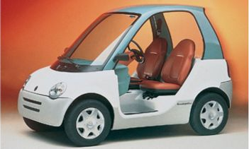
LSV: a 4-wheel vehicle, powered by electricity, with a maximum speed of 40 km/h, which meets the safety requirements set out by Transport Canada for this vehicle class
T²M 2008    Mobility and the Environment    LSVs – Made in Canada Solution, Not Welcome in Canada

Slide 3
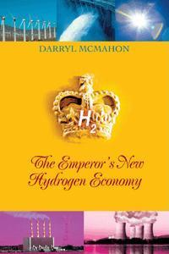


Disclosure: Darryl McMahon
Author – The Emperor's New Hydrogen Economy
and articles related to electric vehicles
Historian – The Electric Auto Association
Co-Founder – The Electric Vehicle Association of
Canada
EV Owner – cars, motorcycles, tractors, boat,
bicycles
President – Econogics, Inc.
Not an LSV / NEV owner or operator
T²M 2008    Mobility and the Environment    LSVs – Made in Canada Solution, Not Welcome in Canada

Slide 4
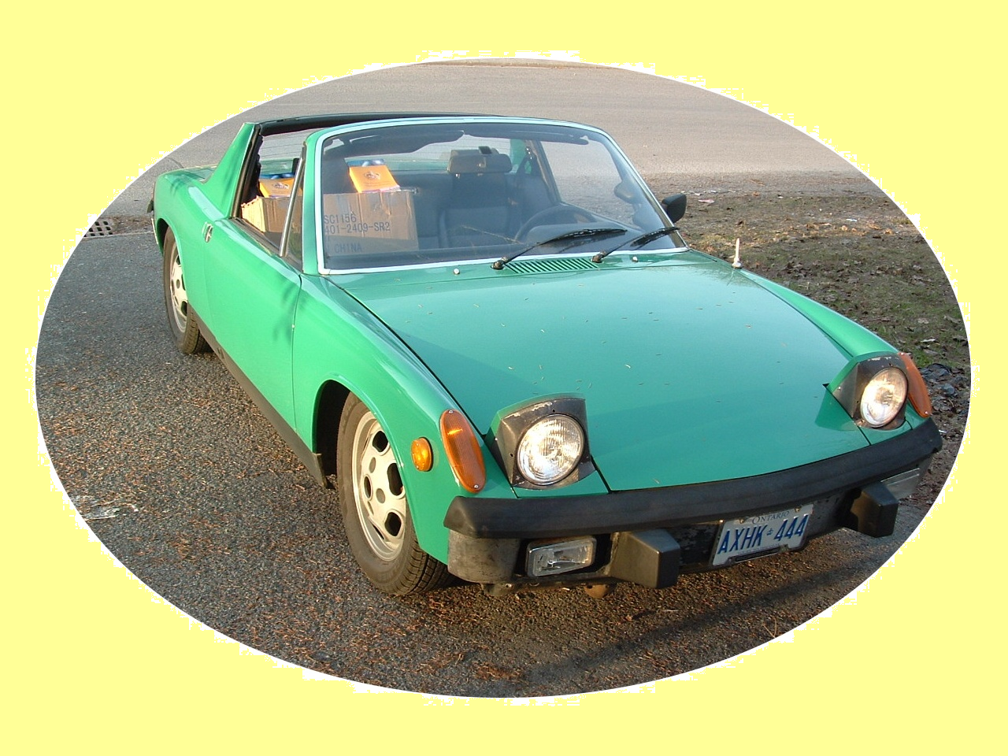
The Green14
1973 Porsche 914 converted to all-electric power
T²M 2008    Mobility and the Environment    LSVs – Made in Canada Solution, Not Welcome in Canada

Slide 5
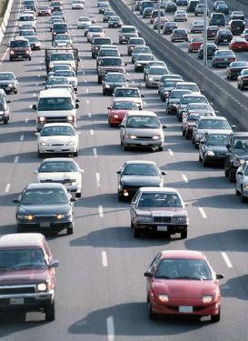
Theme: Mobility
⬅
Increasingly, this is what 'mobility'
looks like in N.A.
If mobility represents freedom,
then the LSV represents freedom from:
dependency on imported oil
vulnerability to the whims of
foreign governments
manipulation by foreign multi-national
oil companies
environmental impacts
health impacts
T²M 2008    Mobility and the Environment    LSVs – Made in Canada Solution, Not Welcome in Canada

Slide 6
Theme: Environment
Electric drive means less:
air pollution (NOx, SOx, VOCs, etc.)
(tailpipes put exhaust right where we breathe)‏
greenhouse gas emissions (notably carbon dioxide)‏
groundwater pollution (underground fuel storage tanks)‏
surface water pollution (small oil leak run-off)‏
thermal pollution
(internal combustion engines are heat engines)‏
noise pollution
T²M 2008    Mobility and the Environment    LSVs – Made in Canada Solution, Not Welcome in Canada

Slide 7
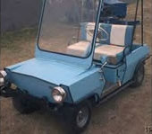
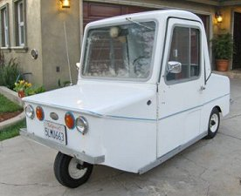
LSV Ancestry - Before 1995
1950s – Marketeer
Top speed: 25 km/h
1960s – Electra King
Top speed: 30 km/h
T²M 2008    Mobility and the Environment    LSVs – Made in Canada Solution, Not Welcome in Canada

Slide 8
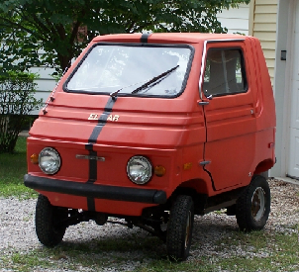
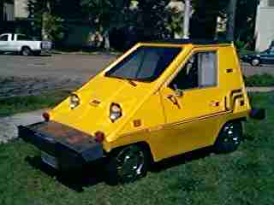
LSV Ancestry - Before 1995
1970s – Zele 1000
Top speed: 50 km/h
1980s – Comuta-Car
Top speed: 55 km/h
T²M 2008    Mobility and the Environment    LSVs – Made in Canada Solution, Not Welcome in Canada

Slide 9
LSVs – More Recent History
1995 – Bombardier begins sales of NV in U.S. sunbelt
(built in Canada)‏
1998 – U.S. government sanctions the NEV / LSV class
(excludes trucks, includes non-electric power)
NHTSA FMVSS Standard 500
In response to Bombardier
2000 – Canadian government effectively adopts U.S.
Standard 500, but electric only
2005 – U.S. incorporates trucks up to 2500 pounds
T²M 2008    Mobility and the Environment    LSVs – Made in Canada Solution, Not Welcome in Canada

Slide 10
LSVs – More Recent History - 2006
U.S. increases LSV GVWR trucks to 3000 pounds
Canada imports 850,000 barrels of oil per day
National population is 80% urban
Average commute (median): 7.6 km
Ontario Medical Association estimates 6,000 premature deaths in Ontario in 2006 due to poor air quality
Ontario launches pilot study with 5 vehicles (already owned and in use in contravention of their own laws prohibiting LSVs) for use only in parks
T²M 2008    Mobility and the Environment    LSVs – Made in Canada Solution, Not Welcome in Canada

Slide 11
LSVs – More Recent History - 2008
January – Electrovaya announces it will produce an LSV
February – B.C. changes regulations
May – Dynasty Motorcar sells production to company in Pakistan
June – Quebec starts pilot project allowing some LSVs, including a truck not permitted by federal regulations
July – Oak Bay (British Columbia) permits LSVs on roads posted up to 50 km/h
T²M 2008    Mobility and the Environment    LSVs – Made in Canada Solution, Not Welcome in Canada

Slide 12
LSVs – More Recent History - 2008
July – Ontario Transport Minister orders another study on LSVs, despite pilot project already in progress
August – Federal government puts new LSV regulations into effect, legalizing LSV trucks, but re-interpreting expected application
September – Canadian Electric Vehicles can sell in Canada
T²M 2008    Mobility and the Environment    LSVs – Made in Canada Solution, Not Welcome in Canada

Slide 13
2008 – Other Happenings
Oil price reaches US$147 per barrel on the spot market.
Even after the price of oil drops back to US$100 per barrel
gasoline pump prices remain high due to refinery capacity
issues.
The Canadian automotive manufacturing sector sheds
jobs and idles capacity due to fuel costs.
Canada is a net exporter of electricity.
Canada's electric grid is sourced roughly 75% from
non-fossil fuel sources.
T²M 2008    Mobility and the Environment    LSVs – Made in Canada Solution, Not Welcome in Canada

Slide 14
LSV Mythology‏
1. No market
Quebec electric-car sales boom
Manufacturers can't meet demand for the vehicles, which will cost about $16,000
Christopher Maughan, Canwest News Service
Published: Saturday, July 19, 2008
MONTREAL -- Quebec's electric car manufacturers say they can't produce their product fast enough to meet demand and have put clients' names on waiting lists.
To hear them tell the story, a revolution is coming thanks to Transport Minister Julie Boulet's announcement that two low-speed, locally-assembled electric vehicles (EVs) would be allowed on some roads as of Friday.
T²M 2008    Mobility and the Environment    LSVs – Made in Canada Solution, Not Welcome in Canada

Slide 15
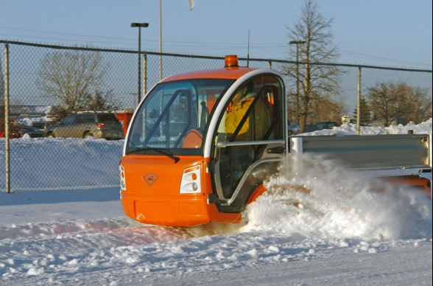
LSV Mythology‏
2. Don't work in the winter
‏
T²M 2008    Mobility and the Environment    LSVs – Made in Canada Solution, Not Welcome in Canada

Slide 16
LSV Mythology‏
3. Not enough electricity to recharge EVs in Canada
Canada is a net electricity exporter – about 70 billion kWh in 2006
Canada has roughly a 60 GW generating capacity surplus at off-peak in Canada)‏
60 million LSVs could be recharged with no additional generating capacity – 2 per person
4. No environmental benefit
Over 75% of electricity in Canada is produced from non-fossil-fuel sources
There are battery recycling programs in place for every rechargeable battery chemistry suitable for use in traction applications.
Ontario Medical Association says over 6,000 premature deaths can be attributed to poor air quality
‏
T²M 2008    Mobility and the Environment    LSVs – Made in Canada Solution, Not Welcome in Canada

Slide 17
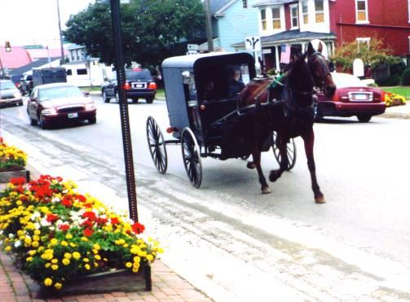
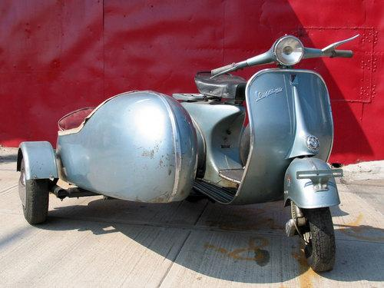
LSV Mythology‏
5. Too slow – at 40 km/h,
LSVs are unsafe on local
roads
But these vehicles are permitted on roads posted up to 80 km/h ...
T²M 2008    Mobility and the Environment    LSVs – Made in Canada Solution, Not Welcome in Canada

Slide 18
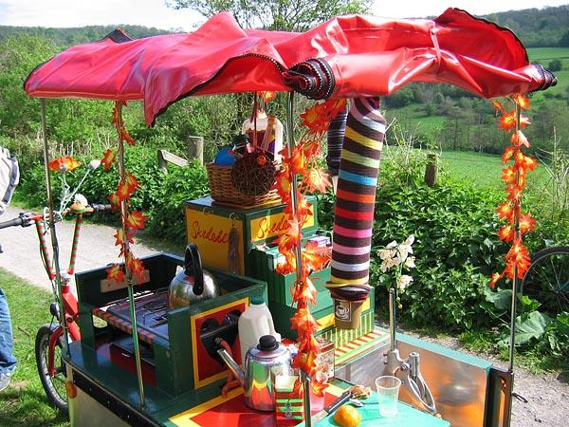
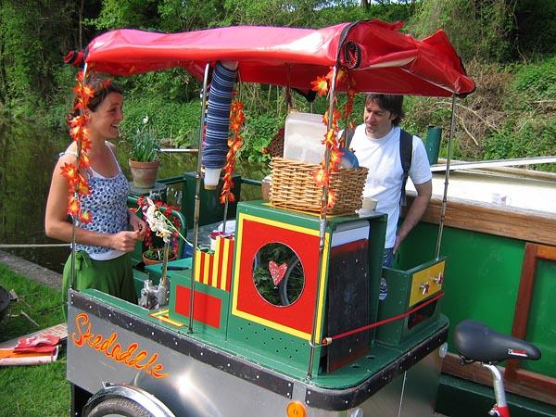
LSV Mythology‏
5. Too slow – at 40 km/h,
LSVs are unsafe on local
roads
... and this one …
T²M 2008    Mobility and the Environment    LSVs – Made in Canada Solution, Not Welcome in Canada

Slide 19
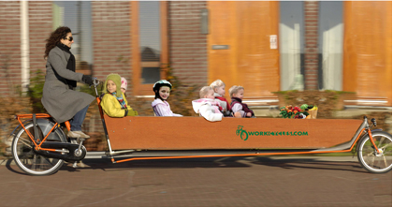
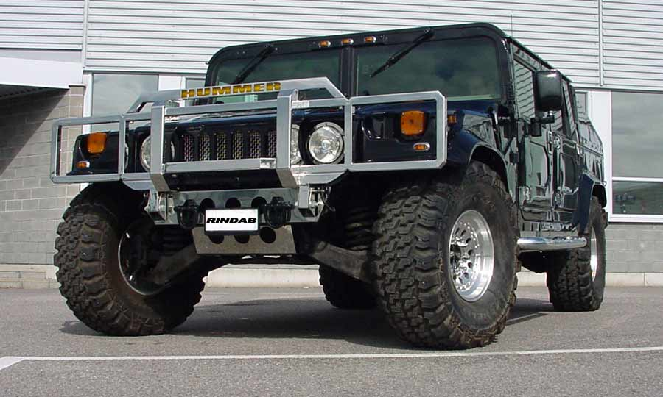

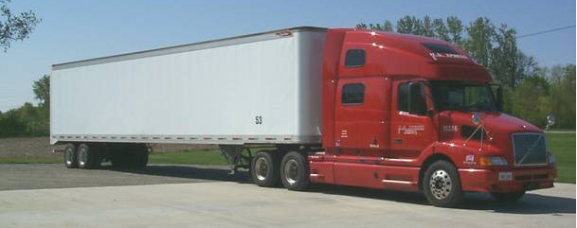
LSV Mythology‏
LSV Mythology‏
LSV Mythology‏
5. Too slow – at 40 km/h,
LSVs are unsafe on local
roads
... and these.
T²M 2008    Mobility and the Environment    LSVs – Made in Canada Solution, Not Welcome in Canada

Slide 20
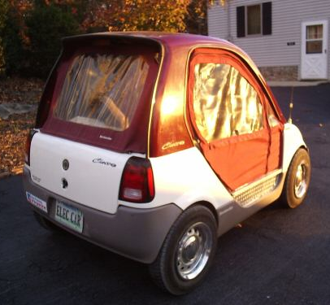
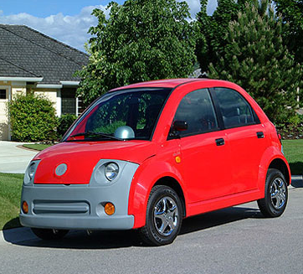
LSV Manufacturers in Canada
Past
Bombardier
Dynasty (2008)‏
T²M 2008    Mobility and the Environment    LSVs – Made in Canada Solution, Not Welcome in Canada

Slide 21
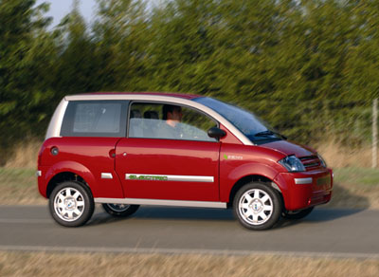
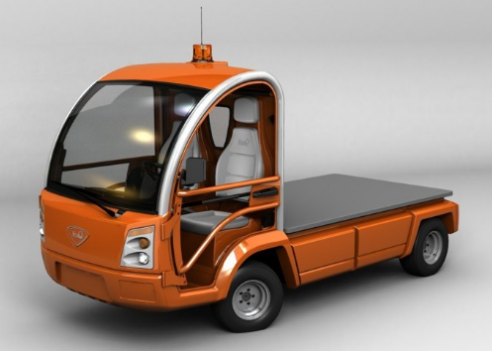
LSV Manufacturers in Canada
Present
Feel Good Cars / ZENN
Nemo
T²M 2008    Mobility and the Environment    LSVs – Made in Canada Solution, Not Welcome in Canada

Slide 22
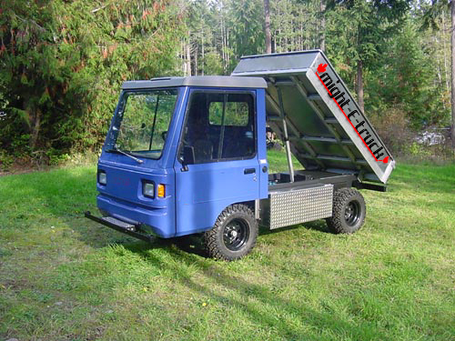
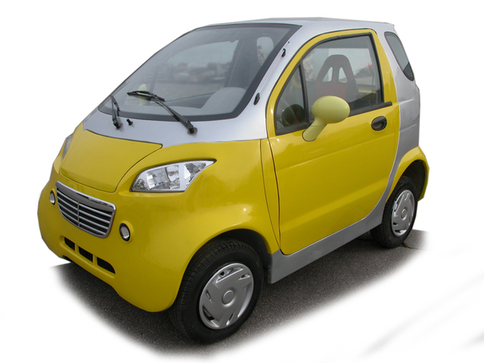
LSV Manufacturers in Canada
Present
Future
Canadian Electric Vehicles
Electrovaya
T²M 2008    Mobility and the Environment    LSVs – Made in Canada Solution, Not Welcome in Canada

Slide 23
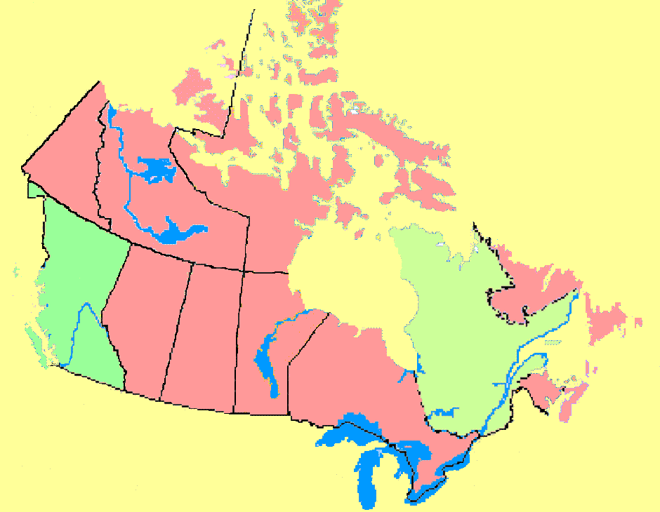
Map Slide
Quebec: 2008 pilot
project – 2 vehicle
types only
British Columbia: 2008
Modifies original regulations
to remove requirement for
additional markings, puts 50km/h
road use in hands of municipalities
T²M 2008    Mobility and the Environment    LSVs – Made in Canada Solution, Not Welcome in Canada

Slide 24
Conclusion
The LSV was invented in Canada by Bombardier
There has been and continues to be a significant interest
in Canada in creating a viable LSV market, both for
domestic consumption and export
The U.S. has embraced the LSV/NEV
Canadians want the LSV
LSV has proven to be safe and an effective class of vehicle
U.S. states are permitting LSVs to operate at speeds up to
35 mph (55 km/h) – 'medium speed vehicles'
T²M 2008    Mobility and the Environment    LSVs – Made in Canada Solution, Not Welcome in Canada

Slide 25
Conclusion
The 2008 Quebec pilot project is a protectionist strategy;
not about long-term, national or global benefits
The 2008 B.C. changes reduce the roads open to LSVs
dramatically
The 2008 federal regulation changes drastically revise the
'recommended' operating space to almost nothing
The current federal ecoAuto environmental incentive
program ignores LSVs, but supports electric-assist hybrids
The barriers to acceptance of the LSV in Canada are not
technological or financial; they are regulatory and institutional
Questions? darryl@econogics.com
T²M 2008    Mobility and the Environment    LSVs – Made in Canada Solution, Not Welcome in Canada

Slide 26
Conclusion
Quebec pilot project is a short-term protectionist act; not a long-term strategy for global benefit
B.C. Regulation changes in 2008 actually more restrictive
The Canadian government’s ecoAuto purchase rebate program for
fuel efficiency includes hybrids but excludes LSVs
The barriers to acceptance of the LSV in Canada are not technological or financial;
they are regulatory and institutional
Questions?
T²M 2008    Mobility and the Environment    LSVs – Made in Canada Solution, Not Welcome in Canada

